Slide 1
Describing, Exploring, and Comparing Data

Slide 2
Descriptive Statistics
Summaries of data are referred to as descriptive statistics
These summaries can be tabular, graphical, or numerical

Slide 3
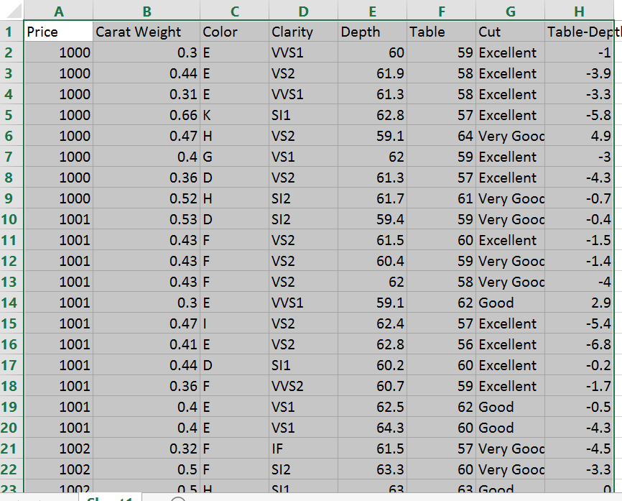
Data – Example – Diamond prices

Slide 4
Frequency Distribution
A tabular summary of data showing the number (frequency of observations in each of several overlapping categories or classes

Slide 5
Relative Frequency
The fraction or proportion of observations belonging to a category
Percent Frequency: The relative frequency multiplied by 100

Slide 6
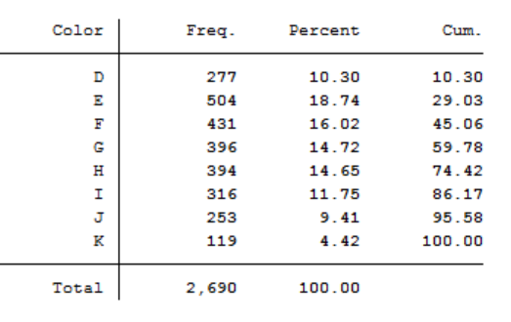
Frequency Table

Slide 7
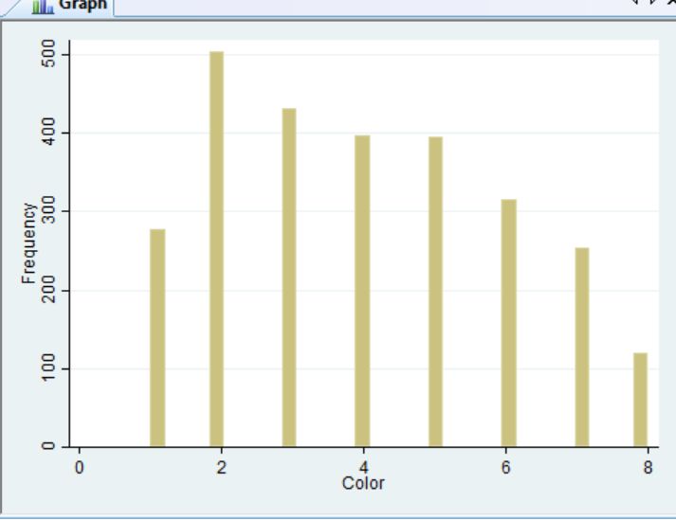
Bar Chart or Histogram

Slide 8
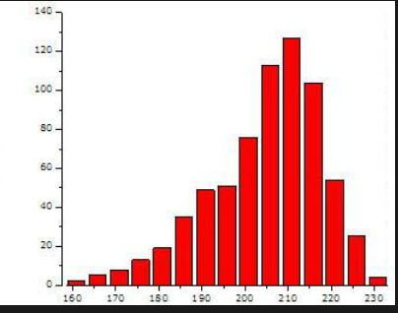
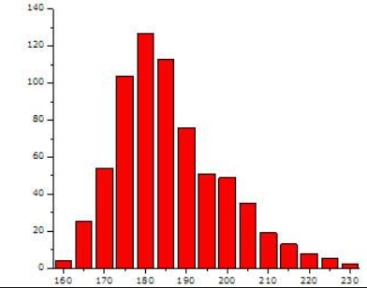
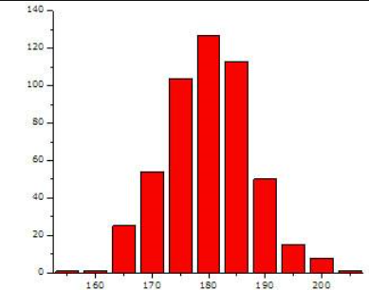
Skewness
Skewed Left
Skewed Right
Symmetric

Slide 9
Creating a histogram
The width for each class, or bin, in a histogram, should be the same between classes. The following formula should be used:
Approximate class width = $\frac{Largest data value −Smallest data value}{Number of classes}$
For quantitative data, it is important to specify class limits so that data does not overlap between categories

Slide 10
Crosstabulation
Tabular summary of data for two variables
Variables can be quantitative, categorical, or one of each

Slide 12
Box Plot - Price

Slide 13
Box Plot - Clarity

Slide 14
Correlation

Slide 15
Scatterplots
Scatterplot: A graph which plots one quantitative variable against another
Used to examine whether there is a relationship between two variables
Analyses of the potential relationship between variables should start with a scatterplot
Notes:
Graphical representations of data are important tools in examining the statistical relationship of variables. While you wouldn’t make a final conclusion about a relationship based on a graph, you can get a sense of the details of the data, as well as check your data entry with a graph.

Slide 16
Suppose we wished to graph the relationship between foot length and height of 20 subjects
In order to create the graph, which is called a scatterplot or scattergram, we need the foot length and height for each of our subjects.
74
72
70
Height
68
66
64
62
60
58
4
6
8
10
12
14
Foot Length

Slide 17
Assume our first subject had a 12 inch foot and was 70 inches tall.
1. Find 12 inches on the x-axis.
2. Find 70 inches on the y-axis.
3. Locate the intersection of 12 and 70.
4. Place a dot at the intersection of 12 and 70.
Height
Foot Length

Slide 18
5. Find 8 inches on the x-axis.
Assume that our second subject had an 8 inch foot and was 62 inches tall.
6. Find 62 inches on the y-axis.
7. Locate the intersection of 8 and 62.
8. Place a dot at the intersection of 8 and 62.
9. Continue to plot points for each pair of scores.

Slide 19
Notice how the scores cluster to form a pattern.
The more closely they cluster to a line that is drawn through them,
the stronger the linear relationship between the two variables is (in this case foot length and height).

Slide 20
If the points on the scatterplot have an upward movement from left to right,
we say the relationship between the variables is positive.
we say the relationship between the variables is negative.
If the points on the scatterplot have a downward movement from left to right,

Slide 21
A positive relationship means that high scores on one variable
are associated with high scores on the other variable
It also indicates that low scores on one variable
are associated with low scores on the other variable.

Slide 22
A negative relationship means that high scores on one variable
are associated with low scores on the other variable.
It also indicates that low scores on one variable
are associated with high scores on the other variable.

Slide 23
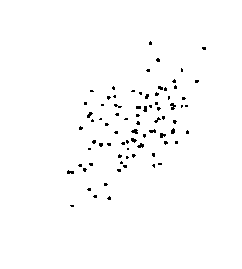
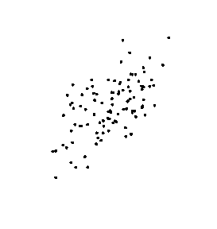
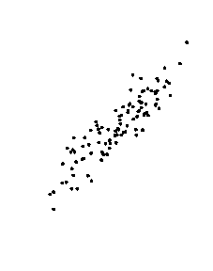
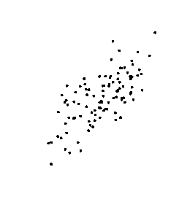
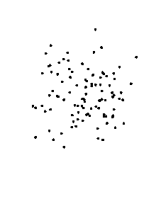
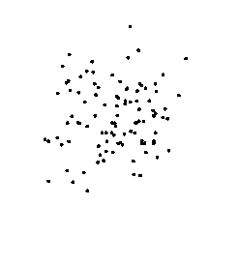
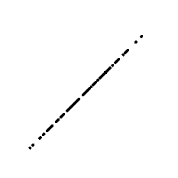
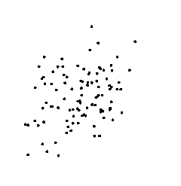
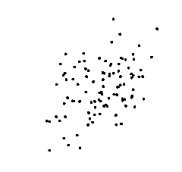
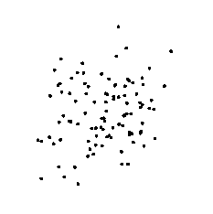
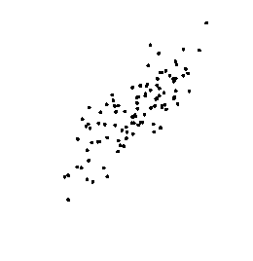
Not only do relationships have direction (positive and negative), they also have strength (from 0.00 to 1.00 and from 0.00 to –1.00).
r = 0.50
r = 0.60
The more closely the points cluster toward a straight line,
the stronger the relationship is.
r = 0.70
r = 0.80
r = 0.00
r = 0.90
r = 0.10
r = 1.00
r = 0.20
r = 0.30
r = 0.40

Slide 24
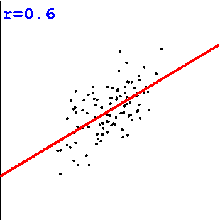
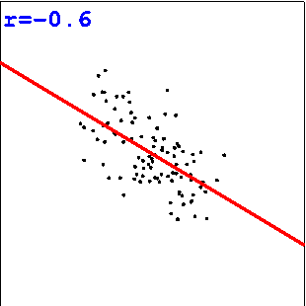
has the same strength as a set of scores with r= 0.60
A set of scores with r= –0.60
because both sets cluster similarly.
Your next mouse click will display a new screen.

Slide 25
Example: Age and Salary of Workers
Age | Salary
20 | $20,000
30 | $45,000
40 | $60,000
50 | $75,000
Notes:
Here is an example data set.
How many variables? (2)
How many observations of each? (4)

Slide 26
Example: Age and Salary of Workers
Variables
Age | Salary
20 | $20,000
30 | $45,000
40 | $60,000
50 | $75,000
Observations
Notes:
Here is an example data set.
We have

Slide 27
Salary
Age
Notes:
Here is a scatterplot.

Slide 28
Example of graphical checking

Slide 29
Positive versus Negative relationship
Positive Relationship: as x increases, y increases
Negative Relationship: as x increases, y decreases
Notes:
Variables are going to be related in one of two ways – either a positive relationship, or a negative one.

Slide 30
Notes:
What type of relationship do these two variables have?

Slide 31
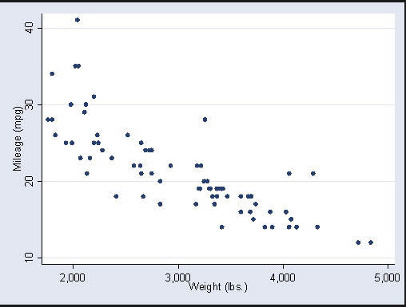
Notes:
This one?

Slide 32
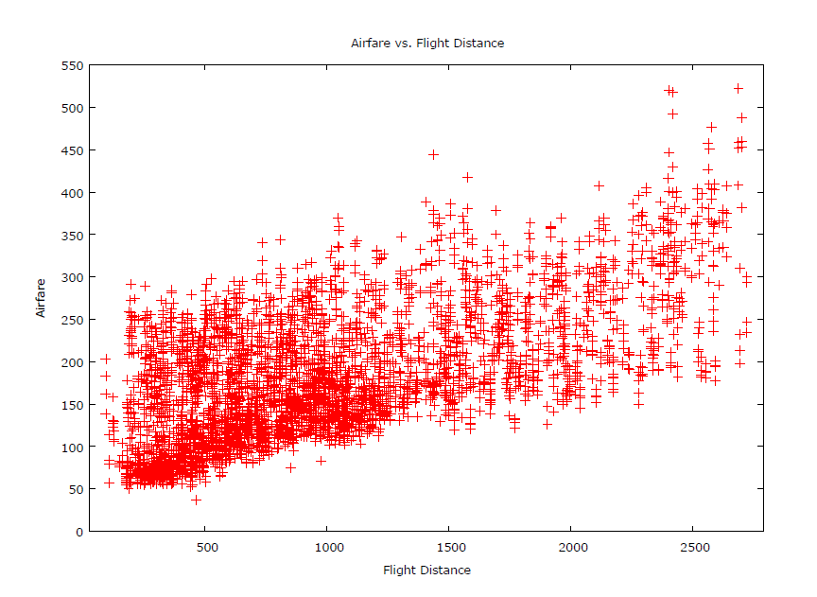
Notes:
What about this one?

Slide 33
Linear and Nonlinear Relationships
Linear Relationship
Slope is constant
Slope is the same for all values of X
Nonlinear Relationship
Slope is not constant
Slope changes as X changes
Notes:
Variables can also be related in either a linear or non-linear fashion.
In a linear relationship, the slope is constant, and the same for all values.
In a non-linear relationship, slope is non-constant.
Which one do you think is more likely in the real world?

Slide 34
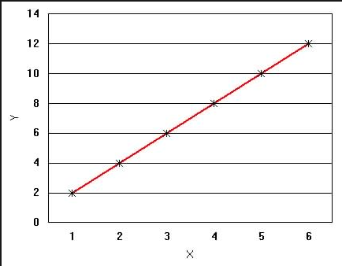

Slide 35
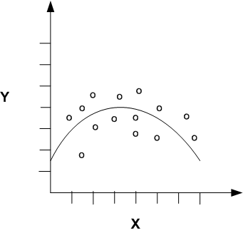

Slide 36
Correlation
Correlation is a statistical measure of the strength of a linear relationship between two variables
Correlation is denoted by the letter r
Correlation is bounded between 1 and -1
r= 1 (perfect positive relationship)
r= -1 (perfect negative relationship)
r= 0 (no relationship)
Notes:
Now we get to the nitty gritty. Correlation, which many people confuse with causation, is a measure of the statistical, linear relationship between two variables.
There are a ton of website devoted to explaining

Slide 37
Calculating Correlation Coefficient
Correlation(r) =
NΣXY - (ΣX)(ΣY) / Sqrt([NΣX² - (ΣX)²][NΣY² - (ΣY)²])

Slide 38
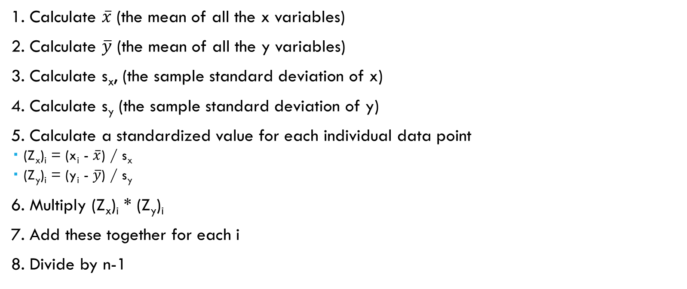
Calculating Correlation Coefficient
1. Calculate $\overline{x}$ (the mean of all the x variables)
2. Calculate $\overline{y}$ (the mean of all the y variables)
3. Calculate s_{x}, (the sample standard deviation of x)
4. Calculate s_{y} (the sample standard deviation of y)
5. Calculate a standardized value for each individual data point
(Z_{x})_{i} = (x_{i} - $\overline{x}$) / s_{x}
(Z_{y})_{i} = (y_{i} - $\overline{y}$) / s_{y}
6. Multiply (Z_{x})_{i} * (Z_{y})_{i}
7. Add these together for each i
8. Divide by n-1

Slide 39
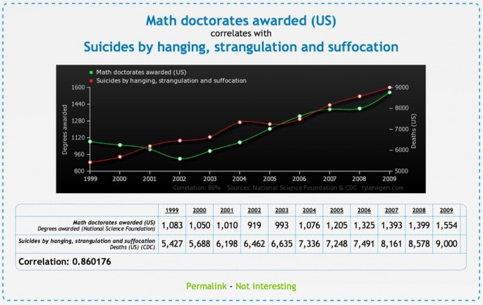

Slide 40
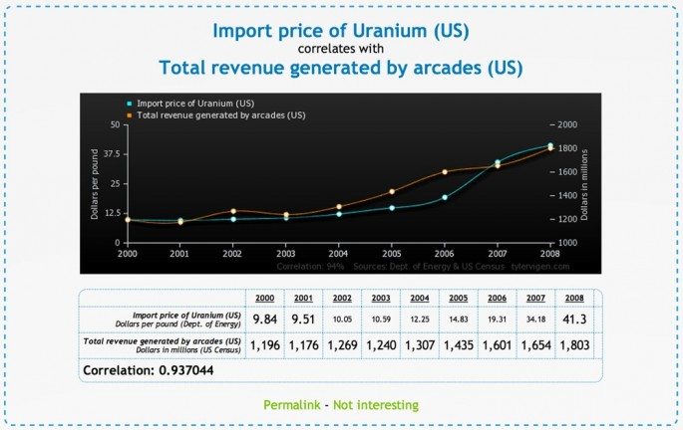

Slide 41
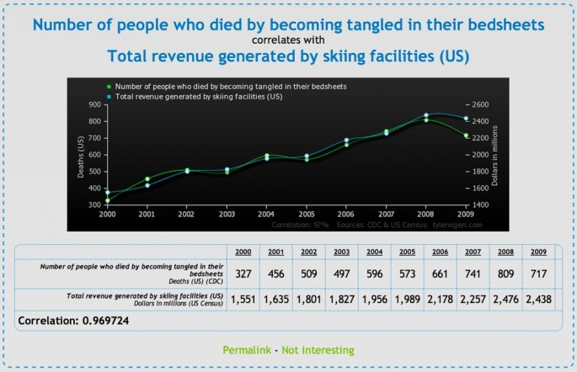

Slide 42
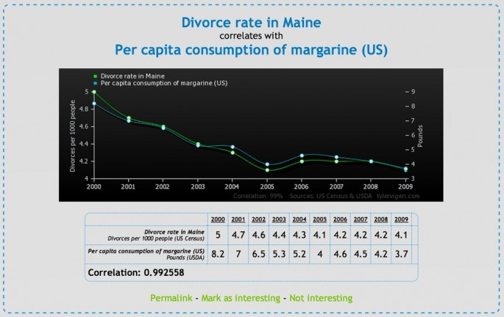

Slide 43
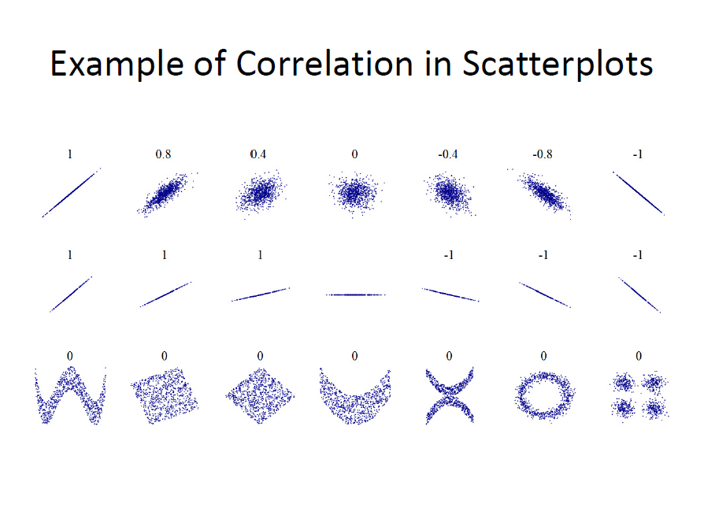

Slide 44
Correlation vs Causation
Correlation implies there is a “relationship”
Causation implies one variable directly influences another variable
Correlation does NOT imply causation
Correlation does NOT imply causation

Slide 45
Correlation vs Causation
There are Three Requirements to Infer a Causal Relationship
A statistically significant relationship between the variables
The causal variable occurred prior to the other variable
There are no other factors that could account for the cause

Slide 46
Example
There is a strong relationship between the number of ice cream cones sold and the number of people who drown each month. Just because there is a relationship (strong correlation) does not mean that one caused the other.
If there is a relationship between A (ice cream cone sales) and B (drowning) it could be because
A->B (Eating ice cream causes drowning)
A<-B (Drowning cause people to eat ice cream-- perhaps the mourners are so upset that they buy ice cream cones to cheer themselves)
A<-C->B (Something else is related to both ice cream sales and the number of drowning-- warm weather would be a good guess)

Slide 47
Hypothesis Testing with Correlation
We can also perform a hypothesis test, the null hypothesis is that there is no correlation between the two variables (i.e. the population correlation coefficient, r, is zero).

Slide 48
Correlation should not be used when:
There is a non-linear relationship between variables
The are outliers
There are distinct sub-groups
If the values of one of the variables is determined in advance

